Slide 1

Map-reduce
a presentation by Haim Fellner Cohen

Slide 2
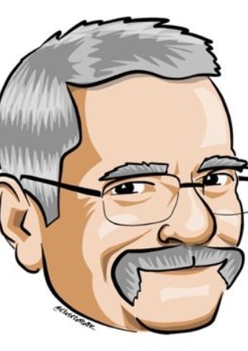
Agenda
3 | Project overview
4 | Self-achievements
5 | architecture
7 | statistics
10 | summary

Slide 3
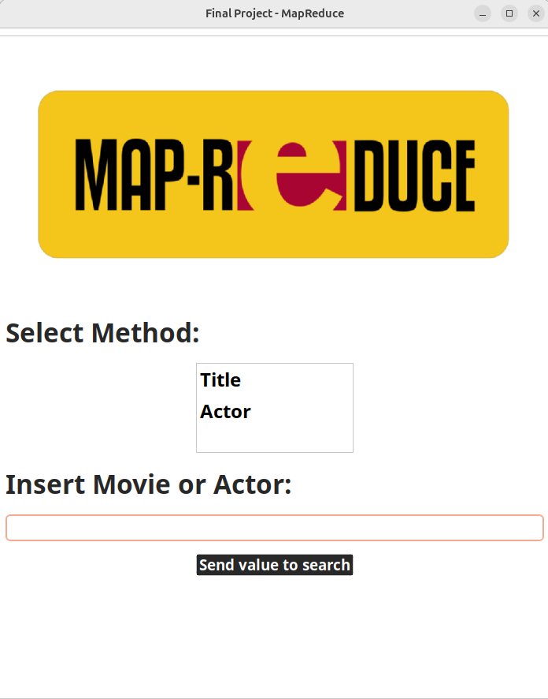
Project overview
Implements a distributed Map-Reduce system to analyze IMDB data, containing movie and actor lists.
Ability to search by movie or actor.
The system uses multiple clients to send queries to a central master.
The master distributes the IMDB records across connected servers, sending specific queries to each.
Results are then returned to the client and visualized as a graph.

Slide 4
Self-achievements
opportunity to learn a functional programming language and build a parallel and distributed system
Erlang
opportunity to learn and implement the Map-Reduce algorithm in Erlang, applying functional programming principles to create a parallel and distributed system for analyzing data
Map-reduce
This project provided the opportunity to design and implement the network and communication structure between multiple computers
communication

Slide 5

architecture
Server 1
server 2
Server m
Master
CLIENT 1
CLIENT 2
CLIENT n

Slide 6
architecture
Master: The master manages all interactions from clients and servers, handling each request with a dedicated process.
Multi-Server: Each server receives an equal amount of the data and executes the Map-Reduce algorithm as needed, based on the client’s query.
Multi-Client: Each client can submit queries to the master and receive targeted responses, displayed in the client’s GUI as graph.

Slide 7
statistics
First Table: Assess and compare the processing speed between actor-based and title-based search queries.
Speed results for Actor Search vs. Title Search.
Performance comparison using 2 servers versus 5 servers to evaluate scalability and efficiency.
Second Table : Measure the performance of the system across multiple criteria (20 different runs).
Metrics for Each PC - Running time per query, Average running time, Standard deviation of running time
System-Wide Metrics - Average and standard deviation across all PCs to evaluate consistency and performance variation.

Slide 8
statistics
System metrics
 | Actor Method | Title Method
3-PCS | System: 2.571 Seconds Each PC (Average): 2.1 seconds | System:6.391 Seconds Each PC (Average): 6 seconds
5-PCS | System: 1.862 Seconds Each PC (Average): 1.4 seconds | System:3.988 Seconds Each PC (Average): 3.5 seconds
Based on 20 different inputs for Actor and for Title Methods

Slide 9
statistics
pc metrics
System metrics
 | Actor | Title
Organize Data Time | 1.696 seconds
MapReduce Time | 1.267 seconds | 3.668 seconds
Standard deviation (MapReduce) | σ: 0.14709 | σ: 0.2318
 | Actor | Title
Average Running Time | 1.862 seconds | 3.988 Seconds
Standard deviation | σ: 0.13444 | σ: 0.21901
Based on 20 different inputs for Actor and for Title Methods – 5 server used

Slide 10
SUMMARY
Developed a distributed Map-Reduce system in Erlang to analyze IMDB movie and actor data.
Central master node manages queries and distributes data across multiple servers; results are visualized as graphs in the GUI clients.
Demonstrated scalability and efficiency with metrics across different configurations, proving its capability to handle large datasets.

Slide 11
“ Make it work, then make it beautiful, then if you really, really have to, make it fast. 90 percent of the time, if you make it beautiful, it will already be fast. So really, just make it beautiful! ”
quote by Joe Armstrong

Slide 12

Questions
Map-Reduce

Slide 13

THANK YOU
Haim Fellner cohen

